Slide 1
Capstone Project Final
BEST LOCATION FOR OPENING AN INDIAN RESTAURANT IN MANHATTAN

Slide 2
1 - Introduction: Business Problem
The goal of the project is to open a Indian Restaurant in Manhattan, so the business problem, is to find the best place for opening the restaurant. The target will be a investor who want to opening a restaurant, and to help him to find the best place base on Data Science algorithm (K-means Cluster).
The main obejective is to find the best neighborhood for opening based on these criterias :
Attractivity of the area
no competition (no other Indian restaurant nearby)
great potential (good review, attractive, crowded area)
Area with lot of restaurant

Slide 3
2 - Data Description to solve the problem
For this Business problem, we will use the API FourSquare for :
Get and analyse the venues of Paris
Finding the neighborhoods, where you can find Lebanese restaurant
Analyse each fo these neighborhood to find the best one, based on these criterias : Good revenues, Attractive area, good reviews etc...
Find a similar neighborhood, but with no Indian restaurant opened yet.

Slide 4
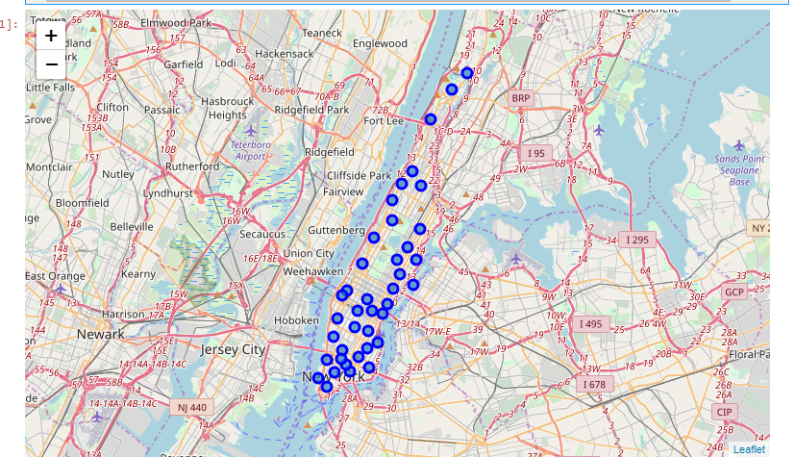
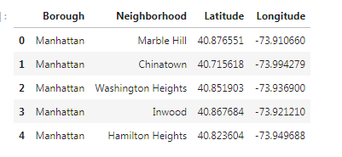
Neighborhood in Manhattan

Slide 5
3 - METHODOLOGY
In this project we will find the best neighborhoods for opening an indian Restaurant in Manhattan area in Ney York City.
So the objective is to find an area with many Indian Restaurant, then to find a similar area but with no or few indian restaurant, for avoiding competitions.
Here are the steps :
The first step will be to analyse the venues for each enighborhood of Manahattan using the Foursquare API.
The second step is to find for each Neighborhood the top ten Venues, then using K-means to cluser them.
The third step is to define which cluster containing the more Indian restaurants.
And finally to find which neighborhoods corresponding to that cluster, but with few Indian restaurant( 0 or 1) for avoiding competition, and visualize it using a map.
We will use Foursquare for searching Indian Restaurants by neighborhood

Slide 6
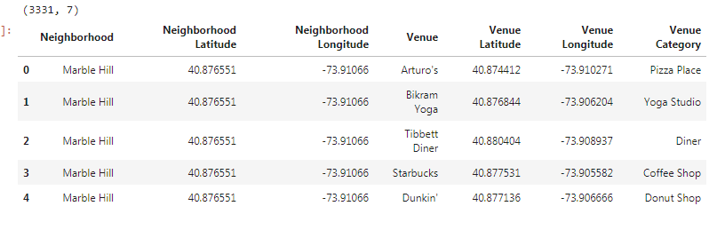
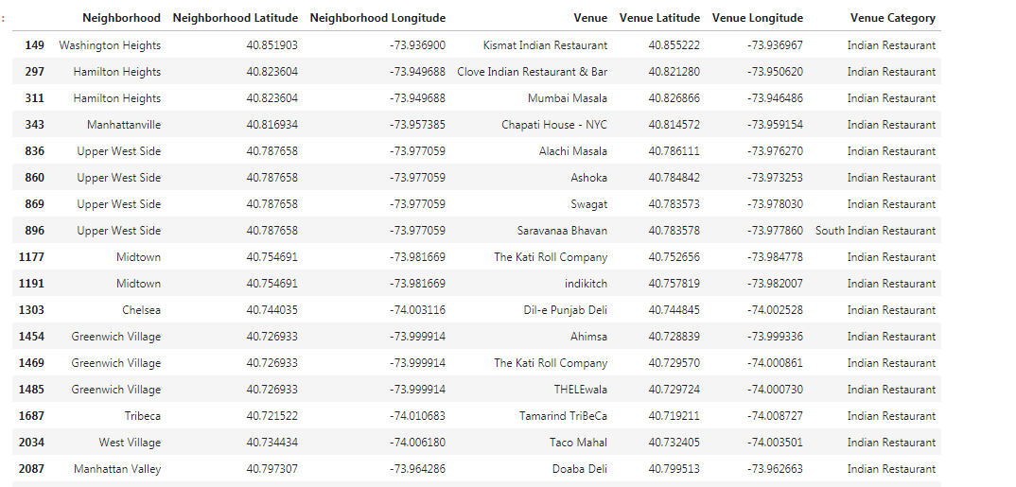
4 - Analysis
Venues categories by Neighborhood
Verification of the presence of Indian restaurants in these neighborhood

Slide 7
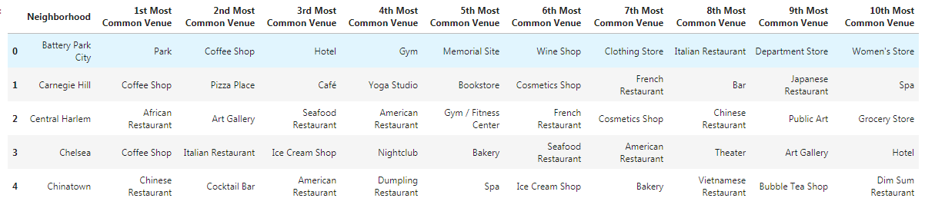
Cluster the Neighborhood
First we will get the top 10 venues for each neighborhood.
We will use k-means to cluster the neighborhood into 5 clusters

Slide 8
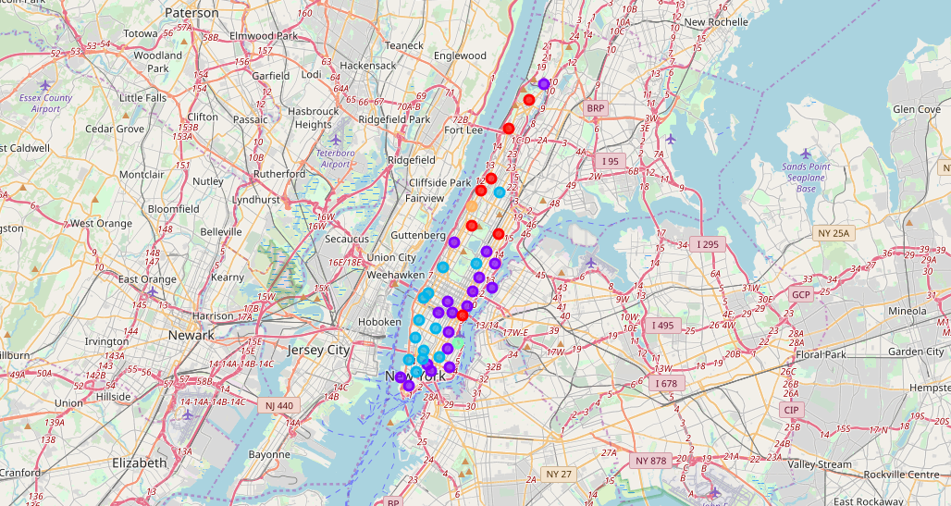
Visualize the clusters on the maps

Slide 9
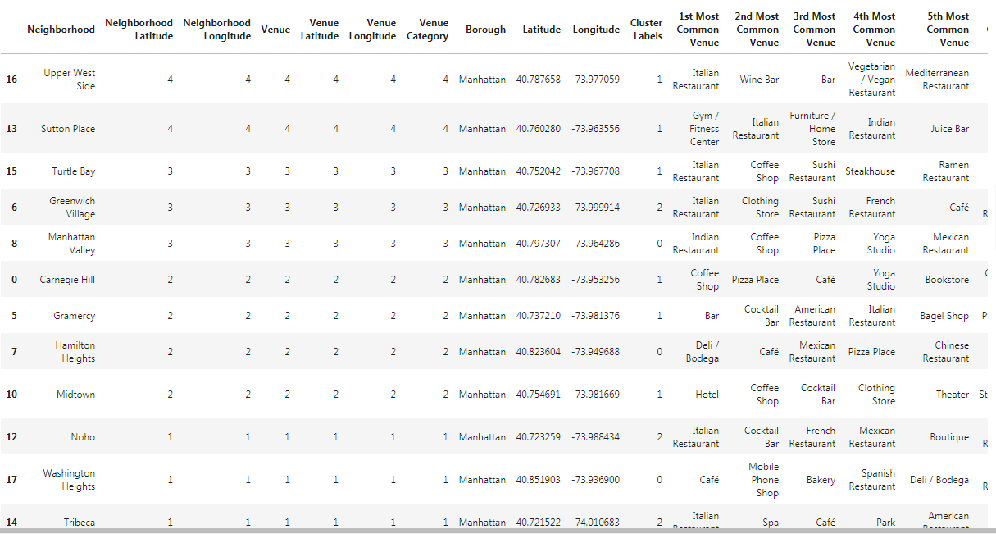
Number of Indian Restaurant By Neighborhood + cluster

Slide 10
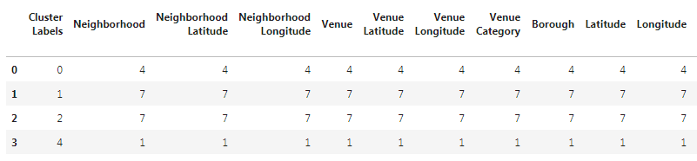
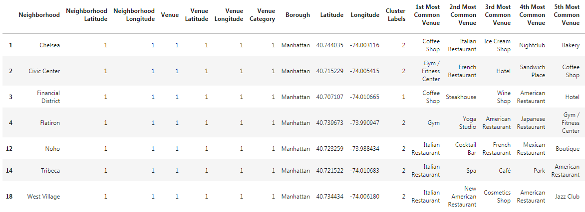
Cluster with the maximum number of indian restarant
Let's focus on these 2 clusters only and find Neighborhoods corresponding to these clusters , but with few indian restaurants, only select the neighborhhood with only 1 Indian restaurant

Slide 11
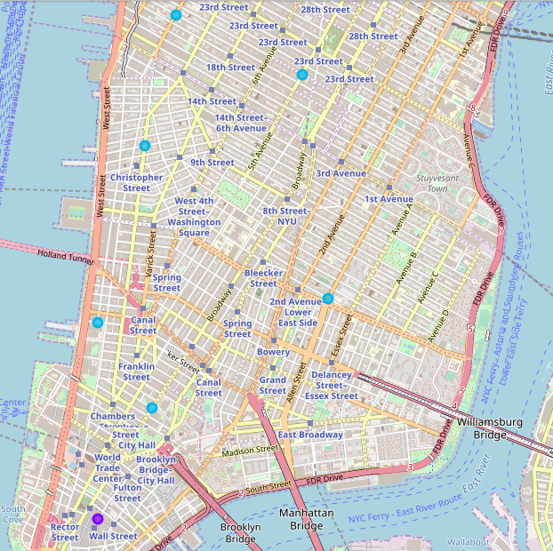
Final selected Neighborhood

Slide 12
5 - RESULTS AND DISCUSSION
So we have found 7 potential neighborhoods for opening an indian restaurants in Manahattan. Their cluster are similar to the one where there are many Indian restaurants.And they have great potential because only 1 indian restaurant is opened in each of these neighborhood.
We can pursue a deeper analysis to find and select which of these neighborhood are the more attractives by using foursquare to get more informations about them such as : Review of the areas, attractivity( tourism) etc...

Slide 13
6 - Conclusion
The goal of the project was to find the best place for opening an indian restaurant in Manhatan by using Data Science algorithm (K-means Cluster).
Finally we have use K-Means algorithm and foursqaure API to find the best clusters (1 or 2) containing a large number of indian restaurant. and found 7 Neighborhood similar as thes clusters, but with just on Indian Restaurant, for avoiding competition.
So these areas has a great potential because there are similiar to areas with a large number of indian restaurant, the top venues are: Bar, Hotel, Italian restaurant etc...

